Slide 1
Uml(unified modeling language)
standard language for specifying, visualizing, constructing, and documenting the artifacts of software systems.

Slide 2
Class Diagram
The class diagram is a static diagram.
describes the attributes and operations of a class and also the constraints imposed on the
system.
shows a collection of classes, interfaces, associations, collaborations and constraints.

Slide 3
Class Diagram
the purpose of the class diagram can be summarized as:
Analysis and design of the static view of an application.
Describe responsibilities of a system.
Base for component and deployment diagrams.
Forward and reverse engineering.

Slide 4
Class Diagram
class diagrams are used for:
Describing the static view of the system.
Showing the collaboration among the elements of the static view.
Describing the functionalities performed by the system.
Construction of software applications using object oriented languages.

Slide 5
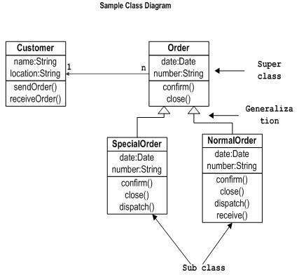
How to draw Class Diagram?

Slide 6
Object Diagram
Object diagrams are derived from class diagrams.
The basic concepts are similar for class diagrams and object diagrams.
Object diagrams are used to render a set of objects and their relationships as an instance.

Slide 7
Object Diagram
the purpose of the object diagram can be summarized as:
Forward and reverse engineering.
Object relationships of a system
Static view of an interaction.
Understand object behaviour and their relationship from practical perspective.

Slide 8
Object Diagram
object diagrams are used for:
Making the prototype of a system.
Reverse engineering.
Modeling complex data structures.
Understanding the system from practical perspective.

Slide 9
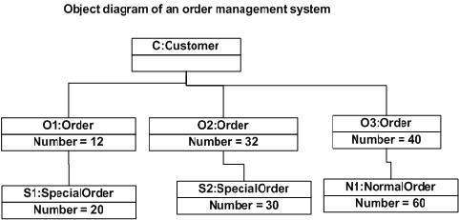
How to draw Object Diagram?

Slide 10
Component Diagram
Component diagrams are used to model physical aspects of a system.
Physical aspects are the elements like executables, libraries, files, documents etc which resides in a node.
used to visualize the organization and relationships among components in a system.
used to make executable systems.

Slide 11
Component Diagram
the purpose of the component diagram can be summarized as:
Visualize the components of a system.
Construct executables by using forward and reverse engineering.
Describe the organization and relationships of the components.

Slide 12
Component Diagram
the usage of component diagrams can be described as:
Model the components of a system.
Model database schema.
Model executables of an application.
Model system's source code.

Slide 13
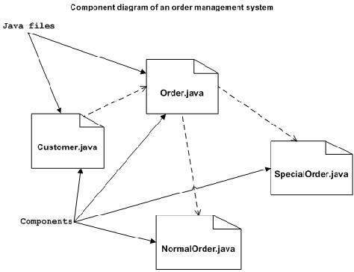
How to draw Component Diagram?

Slide 14
Interaction Diagram
the diagram is used to describe some type of interactions among the different elements in the model.
This interactive behaviour is represented in UML by two diagrams known asSequence diagram and Collaboration diagram.
Sequence diagram emphasizes on time sequence of messages and collaboration diagram emphasizes on the structural organization of the objects that send and receive messages.

Slide 15
Interaction Diagram
the purposes of interaction diagram can be describes as:
To capture dynamic behaviour of a system.
To describe the message flow in the system.
To describe structural organization of the objects.
To describe interaction among objects.

Slide 16
Interaction Diagram
the usages of interaction diagrams:
To model flow of control by time sequence.
To model flow of control by structural organizations.
For forward engineering.
For reverse engineering.

Slide 17
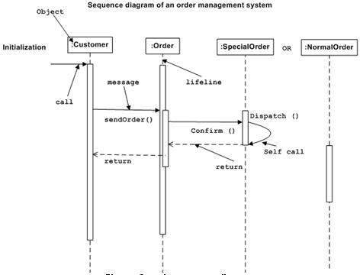
The Sequence Diagram

Slide 18
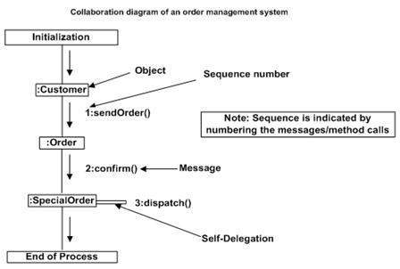
The Collaboration Diagram

Slide 19
Use Case Diagram
use case diagrams are consists of actors, use cases and their relationships.
The diagram is used to model the system/subsystem of an application.
A single use case diagram captures a particular functionality of a system.

Slide 20
Use Case Diagram
the purposes of use case diagrams can be as follows:
Used to gather requirements of a system.
Used to get an outside view of a system.
Identify external and internal factors influencing the system.
Show the interacting among the requirements are actors.

Slide 21
Use Case Diagram
use case diagrams are used:
Requirement analysis and high level design.
Model the context of a system.
Reverse engineering.
Forward engineering.

Slide 22
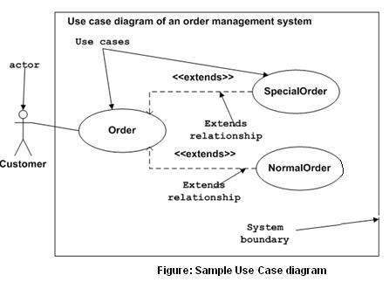
How to draw Use Case Diagram?

Slide 23
Statechart Diagram
describes different states of a component in a system.
The states are specific to a component/object of a system.
A Statechart diagram describes a state
machine.
state machine can be defined as a machine which defines different states of an object and these states are controlled by external or internal events.

Slide 24
Statechart Diagram
the main purposes of using Statechart diagrams:
To model dynamic aspect of a system.
To model life time of a reactive system.
To describe different states of an object during its life time.
Define a state machine to model states of an object.

Slide 25
Statechart Diagram
the main usages can be described as:
To model object states of a system.
To model reactive system. Reactive system consists of reactive objects.
To identify events responsible for state changes.
Forward and reverse engineering.

Slide 26
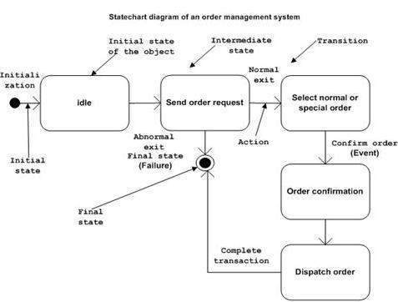
How to draw Statechart Diagram?

Slide 27
Activity Diagram
Activity diagram is basically a flow chart to represent the flow form one activity to another activity.
The activity can be described as an operation of the system.
the control flow is drawn from one operation to another.

Slide 28
Activity Diagram
the purposes can be described as:
Draw the activity flow of a system.
Describe the sequence from one activity to another.
Describe the parallel, branched and concurrent flow of the system.

Slide 29
Activity Diagram
the main usages of activity diagram:
Modeling work flow by using activities.
Modeling business requirements.
High level understanding of the system's functionalities.
Investigate business requirements at a later stage.

Slide 30
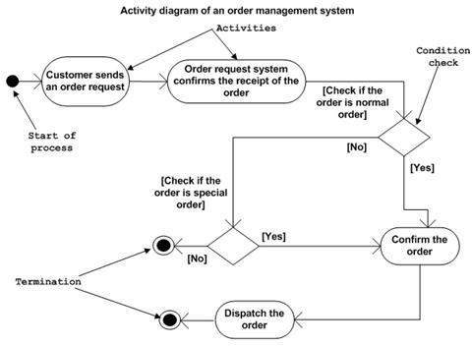
How to draw Activity Diagram?

Slide 31
Deployment Diagram
used to visualize the topology of the physical components of a system where the software components are deployed.
used to describe the static deployment view of a system. Deployment diagrams consist of nodes and their relationships.

Slide 32
Deployment Diagram
The purpose of deployment diagrams can be described as:
Visualize hardware topology of a system.
Describe the hardware components used to deploy software components.
Describe runtime processing nodes.

Slide 33
Deployment Diagram
the usage of deployment diagrams can be described as follows:
To model the hardware topology of a system.
To model embedded system.
To model hardware details for a client/server system.
To model hardware details of a distributed application.
Forward and reverse engineering.

Slide 34
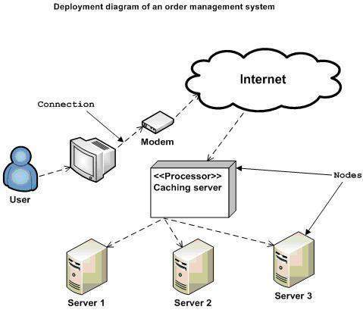
How to draw Deployment Diagram?

